Slide 1
Hanyang Personal Gym Trainer
Mickael NGUYEN
Kobe GROBBEN
William CHAN
Fabian BECK
Software Engineering project

Slide 2
Structure
Use Case Diagram
Overall Architecture
Demonstration
Login/Registration
Main Page
Settings
Workout Session
Map
Conclusion

Slide 3
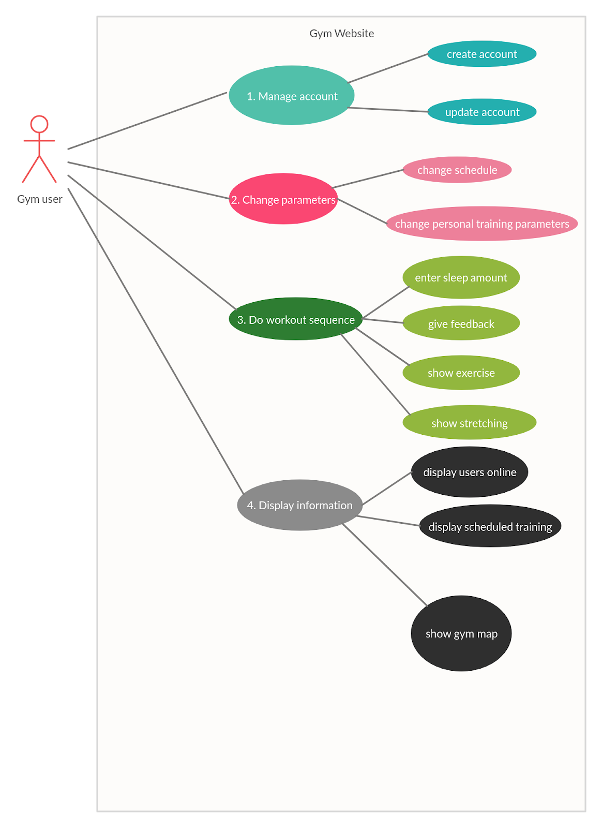
Use-case Diagram

Slide 4
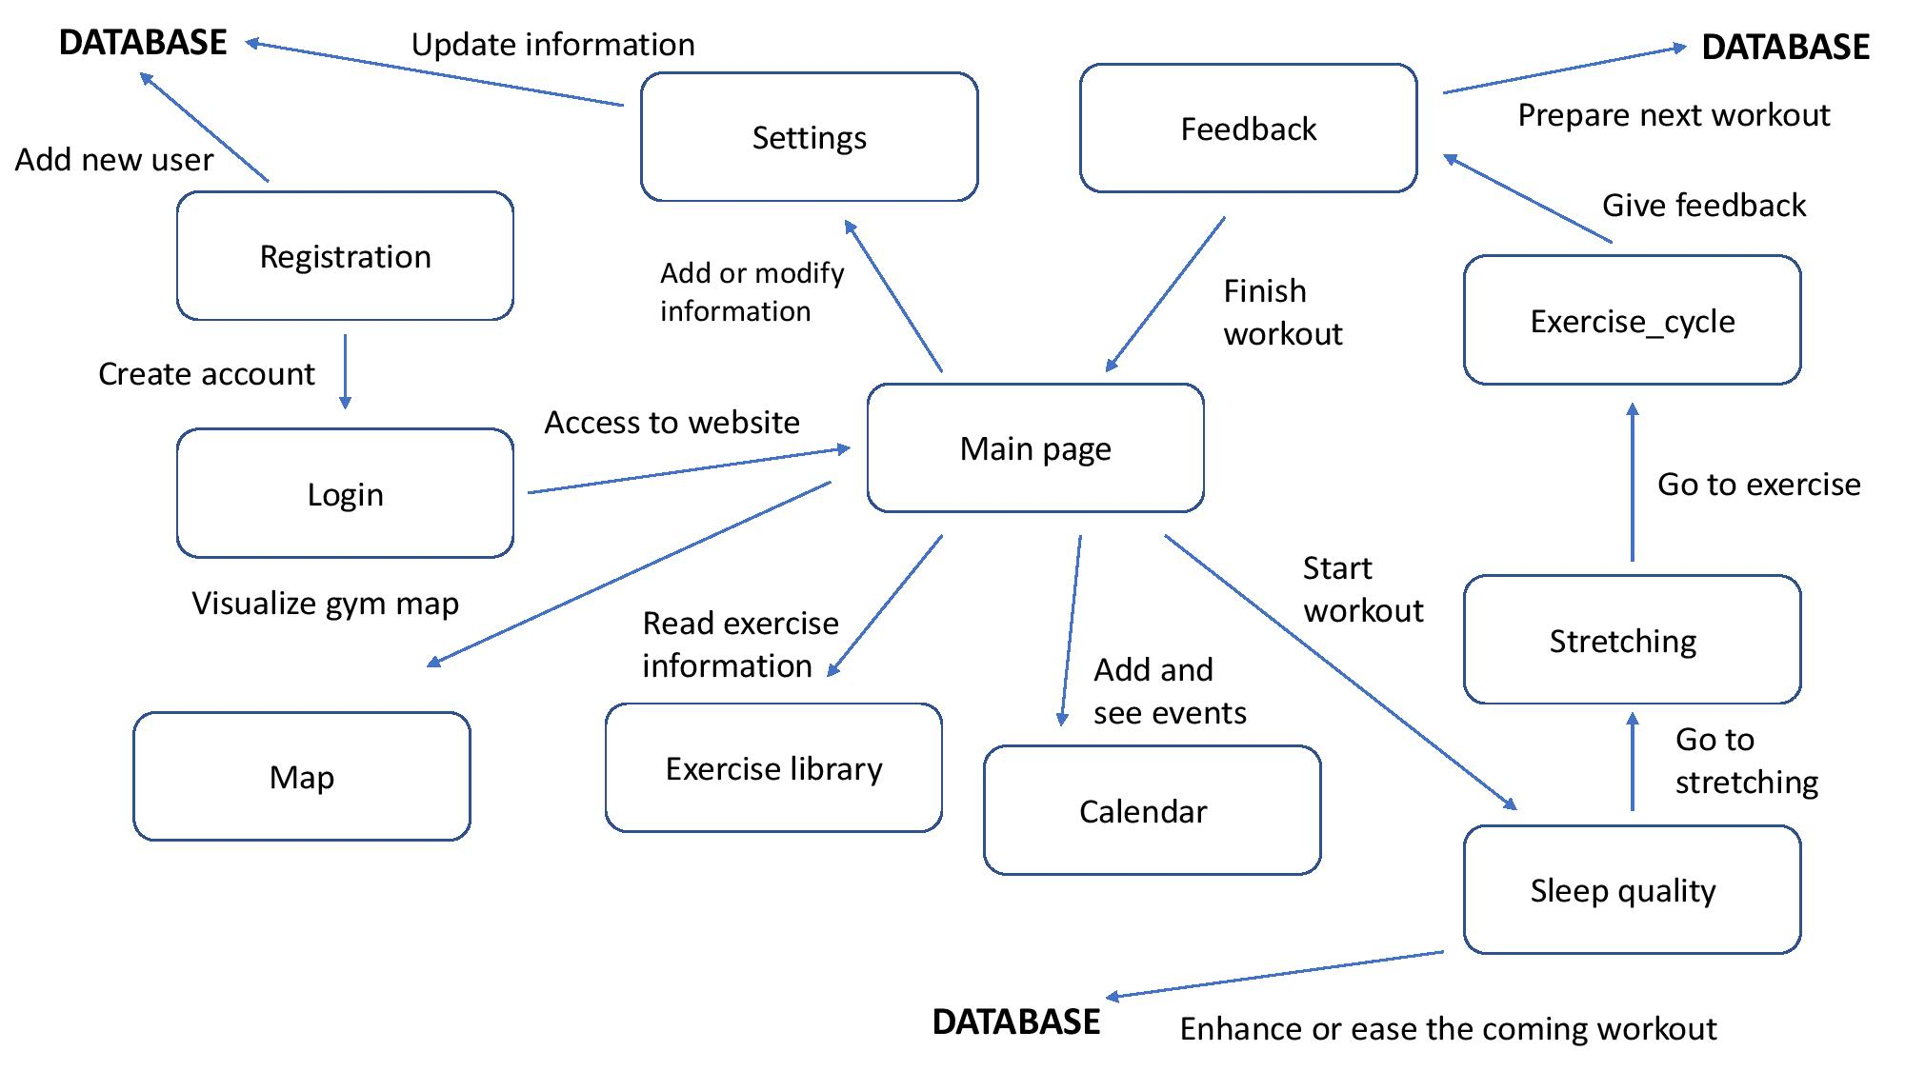
Overall architecture

Slide 5
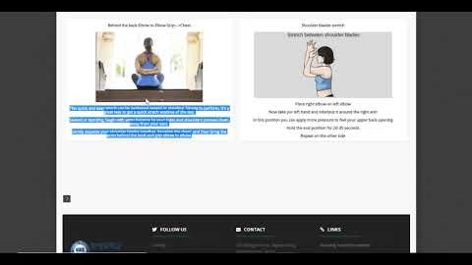
Demo
Notes:
https://www.youtube.com/watch?v=mEImX3FLe1w&feature=youtu.be

Slide 6
Conclusion
Unique features:
Take sleep quality as indicator for workout performance
Unique weight modification
Special guidance during workout
Unfinished requirements:
Delete account
Calendar
Real time user activity
Automatically generate workout schedule

